Slide 1
5-star Reviews
A 5 Step Program for Small Business Success
Kin-Yip

Slide 2
Motivation
82% of consumers read online reviews for local businesses.¹
76% of consumers trust online reviews as much as recommendations from family and friends.¹
A one-star increase in yelp rating leads to a 5-9% increase in revenue.²

Slide 3
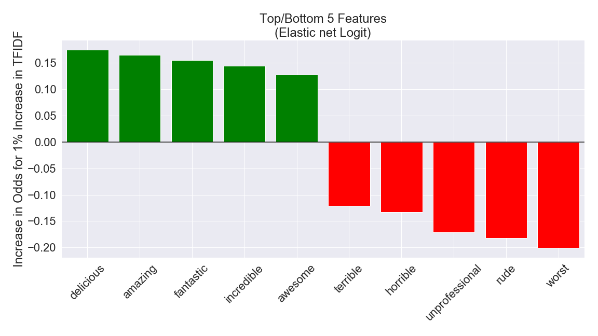
Step 1: What Makes a 5-star Review?
Words that separate 5-star and 1-star reviews.

Slide 4
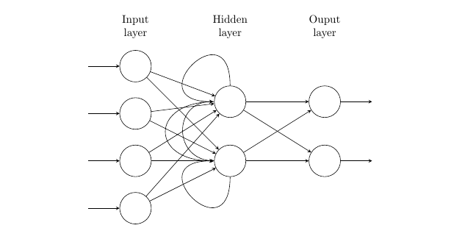
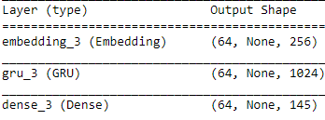
Step 2: Get 5-star Reviews
Option 1: Be amazing.
Option 2: Buy reviews. ($20-27 per review)
Option 3: Create your own.

Slide 5
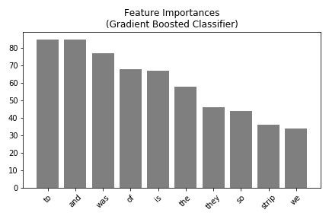
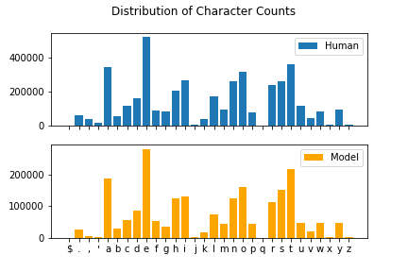
Step 3: Evaluate Reviews
Model | Token | Accuracy
LightGBM | char | 0.770
LightGBM | word | 0.844
Swivel NN | word | 0.997

Slide 6
Step 4: Repeat Steps 2-3 As Needed
Train on GPUs with more cores (mine has 384 cores):
Google Colaboratory:
NVIDIA TESLA K80 (12 hrs/session) -- 2496 cores, 12 GB VRAM
Kaggle:
NVIDIA TESLA P100 (30 hrs/week) -- 3584 cores, 12-16 GB VRAM
AWS:
NVIDIA TESLA P100 (4-8 gpus) -- $12-24/hr

Slide 7
Step 5: Deploy
Seed: "The Americano at Chul's was amazing"
“The Americano at Chul's was amazing!
I of course I would say that it is a half mix and got a free meal and helpful. The waitress was a giant chocolate and salmon menu. They are fantastic and friendly and helpful. The musical was the perfect temperature to what you pay for it. You can advertise in the past trying to get a drink.”

Slide 8
References
Murphy, Rosie. “Local Consumer Review Survey: Online Reviews Statistics & Trends.” BrightLocal, 28 Jan. 2020, www.brightlocal.com/research/local-consumer-review-survey/.
Luca, Michael. "Reviews, Reputation, and Revenue: The Case of Yelp.com." Harvard Business School Working Paper, No. 12-016, September 2011. (Revised March 2016. Revise and resubmit at the American Economic Journal - Applied Economics.)

